Slide 1

Data Science Presentation Presentation
By: Quiete Rankwe

Slide 2





Project analysis slide 2
Contents
What is Machine Learning
The Data Science Process
Problem Description
Loading and preparing Data
Exploratory Data Analysis
Loading and preparing Data
Feature Engineering and Selection
Model Development and Evaluation
Model Development and Evaluation
Model Deployment
Model Deployment

Slide 3
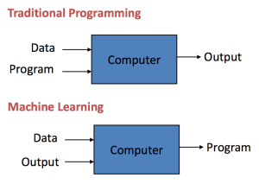
Project analysis slide 2
What is Machine Learning
Machine learning is an application of artificial intelligence (AI) that provides systems the ability to automatically learn and improve from experience without being explicitly programmed.

Slide 4
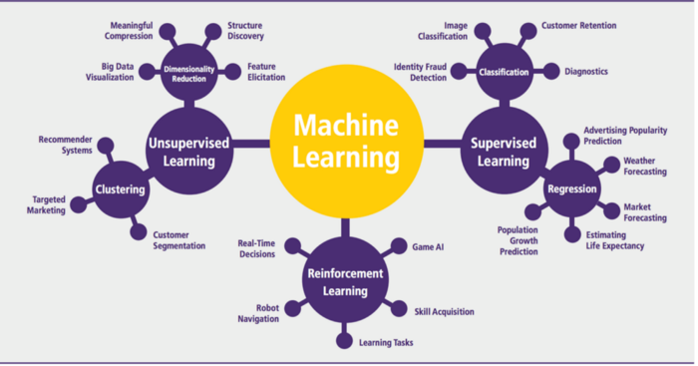
Project analysis slide 2
What is Machine Learning

Slide 5
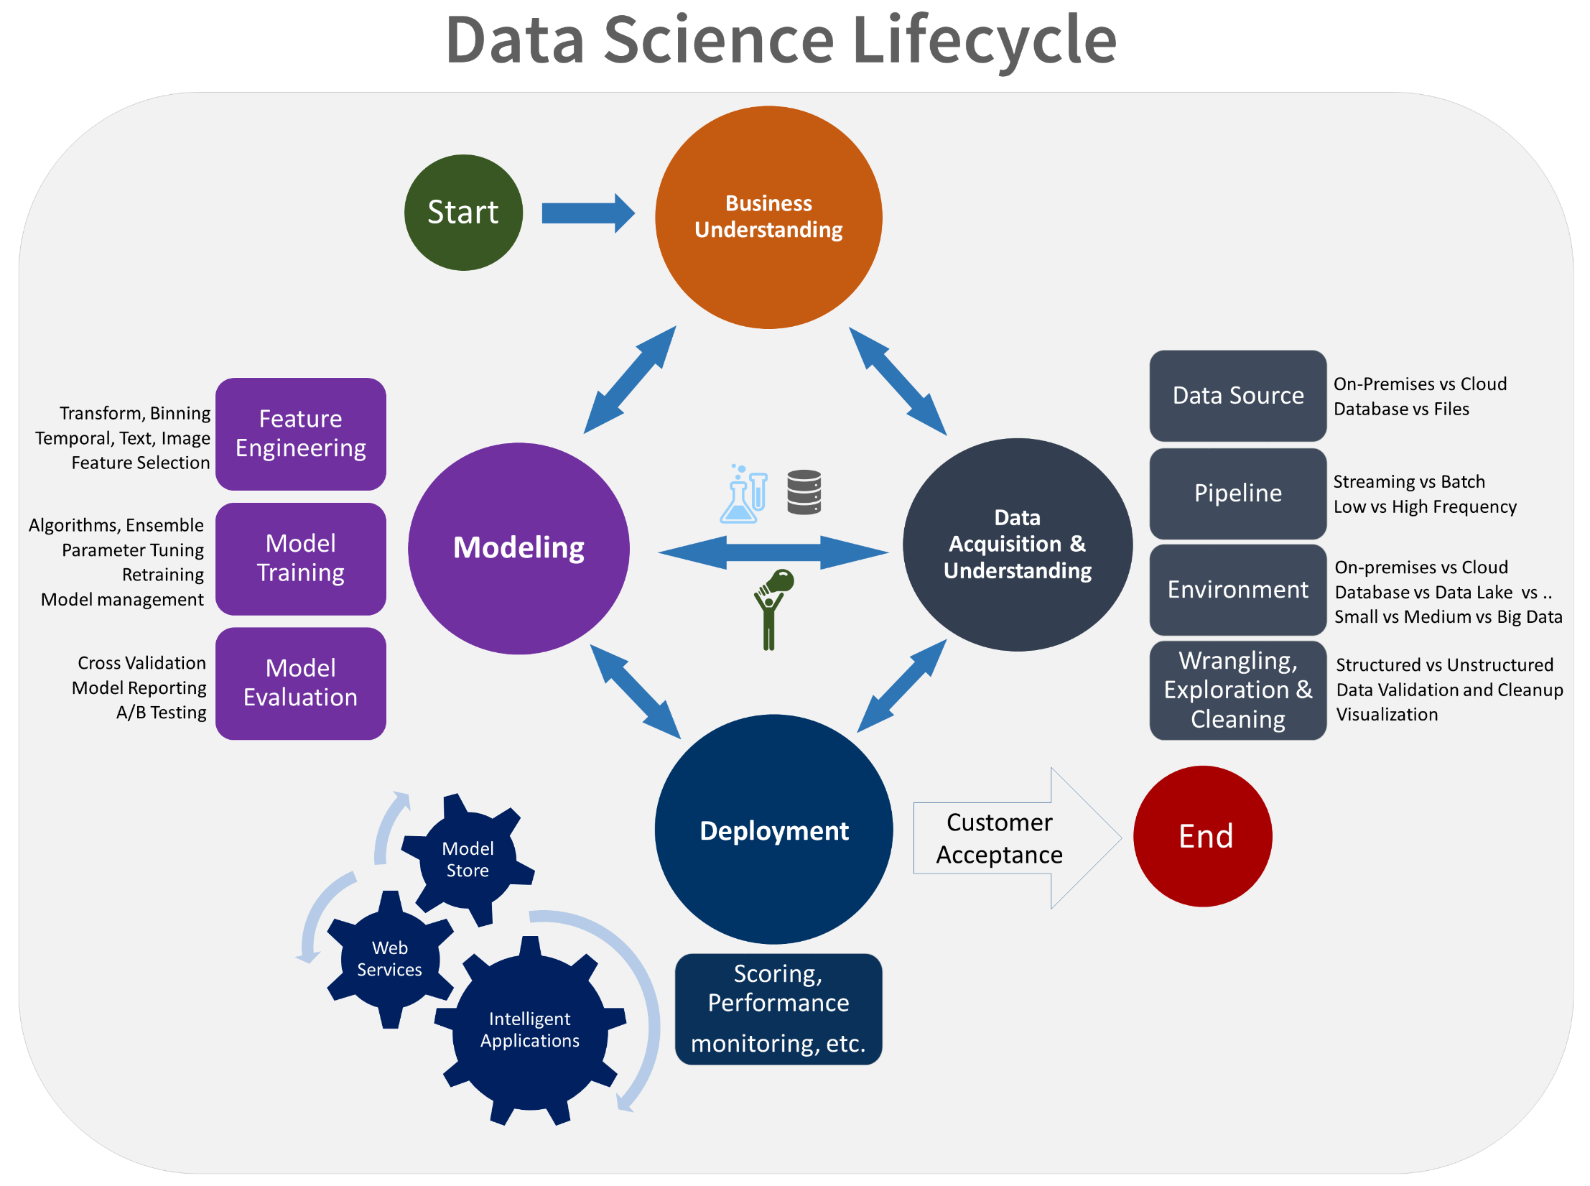
Project analysis slide 2
Data Science Process

Slide 6
Project analysis slide 3
Problem Description
According to the World Health Organization (WHO) stroke is the 2nd leading cause of death globally, responsible for approximately 11% of total deaths.
This dataset is used to predict whether a patient is likely to get stroke based on the input parameters like gender, age, various diseases, and smoking status. Each row in the data provides relevant information about the patient.

Slide 7
Project analysis slide 4
Data Loading and Exploration.
For preparations: Firstly we import the necessary libraries and load the files to the notebook needed for our Task.
The libraries we will use initially are pandas for loading and handling the dataset as a data frame. Seaborn and matplotlib used for visualization, and numpy used for mathematical and statistics purposes.
Analyse the first few rows of the data to check if it has loaded properly and looks the way we expect it. Then get the shape and the number of columns/features in the data set (shape was found to be 12 features and 5110 entries).
Data types found were text, numerical integers and floats.
When checking for missing values: the bmi column was found to have nulls and mean bmi was used to fill up these missing values.

Slide 8
Project analysis slide 5
Feature Selection
We have 11 features plus the target variable. We need to know which are important so that we can eliminate the useless ones.
We use a technique called Feature importance, Feature importance gives you a score for each feature of your data. The higher the score is; the more important or relevant is the feature towards your output variable.
We use inbuilt class that comes with Tree Based Classifiers. We will be using the Extra Tree Classifier for extracting the top 10 features for the dataset.

Slide 9
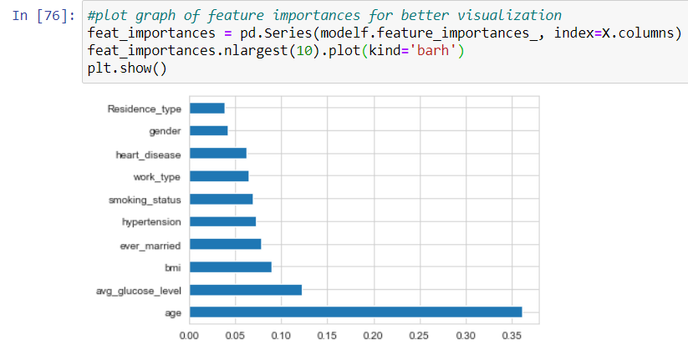
Project analysis slide 5
Feature Selection - Results
Age is the most important Feature. It affects the target variable at a much higher rate compared to the rest of the features.
We will remove the residence type and gender as the have very low importance.

Slide 10
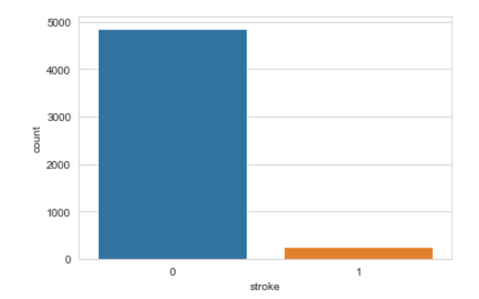
Project analysis slide 5
Model Development
Our goal is to develop a model that’s determines whether a person has a potential of suffering from stroke.
The target variable is labelled as 1 for patients who have stroke and 0 for those who do not have stroke
Target variable is labelled, therefore Supervised learning is best fit.
Count comparison, the dataset is skewed towards False.

Slide 11
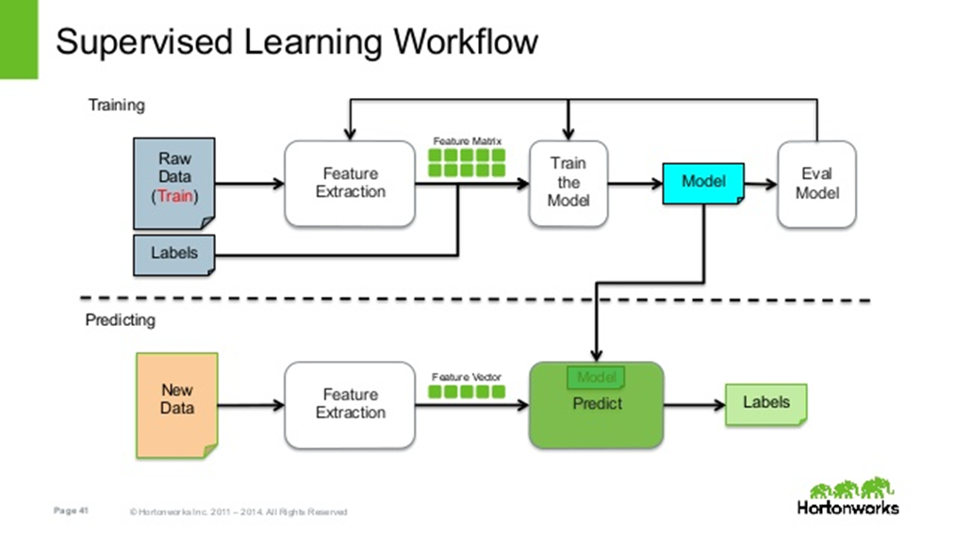
Project analysis slide 5
Model Development – Supervised Learning
Process of an algorithm learning from the training dataset.
Decision tree algorithm is ideal for binary classification.
Data is split into two. 1- Training data to be used for training the model and, 2 - Testing data that will be used to evaluate the performance of the model.
The model is fed the training data as per the top significant features identified in the Feature Selection section.
Upon training completion, we now predict using the test dataset.

Slide 12
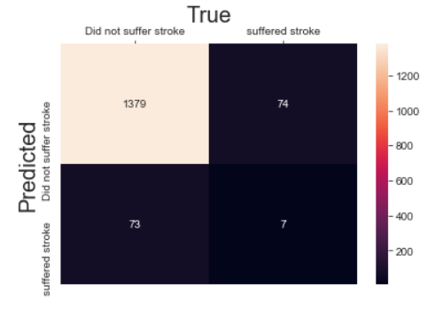
Project analysis slide 5
Evaluation and Results
The model was evaluated and scored, the score of the model was found to be 90% using sci kit learn method accuracy score.
This means that the model predicts correctly 90% of the data given to it.
Further actions could be taken such as observation of what happens if the data is normalized or standardized.
If the model did not give a good score, the next step would be to tune the hyper parameters to find the most optimal combination.
If tuning is not yielding results, the next step would be to look at other classification models such a Support Vector Machine, Naive Bayes, random forest or ensemble methods.

Slide 13

Project analysis slide 10
Model Deployment
The Last stage of the machine Learning Life Cycle.
Its is the method by which we integrate machine learning model into a production environment to make practical decisions
We want to avail the power of machine learning models to real life situation at real time.
Batch Training
Real-time predictions
Historical Data
Model
predictions
Live Data
Feedback

Slide 14
Project analysis slide 10
Model Deployment
Machine Learning DevOps(MLOps)
The goal of building a machine learning model is to solve a real world problem, so the model must be exposed to real time environment.
Key Areas:
Data storage and retrieval
Frameworks and tooling
Feedback and iteration

Slide 15
Project analysis slide 10
Model Deployment - Model serving
The validated model is deployed to a target environment to serve predictions
An embedded model to a web application or mobile device.
Microservices with a REST API to serve online predictions.
Part of a batch prediction system.
Business System
Live Data
ML Model
Results from the model

Slide 16
Project analysis slide 10
Model Deployment – Data Storage and Retrieval
Every machine learning model is associated with data, we need to know the logistics of that data:
1. How is your training data stored?
Data can be stored in on-premise, in cloud storage, or in a hybrid of the two. It is best to deploy the model where the data is stored.
2. How large is your data?
Large dataset = more computing power, auto-scaling in a cloud environment is ideal as it helps you with budgeting.
3. How will you retrieve the data for training?
Batch or real time?
4. How will you retrieve data for prediction?
Webpages, APIs, batch or real time?
For batch inference, you might want to save a prediction request to a central store and then make inferences after a designated period, while in real-time, prediction is performed as soon as the inference request is made.

Slide 17
Project analysis slide 10
Model Deployment – Frameworks and tooling
Problem statement, nature of the data and organization infrastructure determines that tools and frameworks to be used.
The choice of framework can decide the continuity, maintenance, and use of a model.
1. What is the best tool for the task at hand?
Efficiency: optimal use of memory, CPU, and time.
Popularity: Popularity often means it works well, is actively in use, large community and has a lot of support.
2. Are the choice of tools open-source or closed?
Open source = cut costs but is it flexible to integrate with your business structure?
3. How many platforms/targets support the tool?
Does this framework support popular platforms like the web or mobile environments? Does it run on Windows, Linux, or Mac OS? Is it easy to customize or implement in this target environment?

Slide 18
Project analysis slide 10
Model Deployment – Feedback and iteration
We need to track and receive feedback from the model in production.
Receive warning, exceptions on state of the model performance. This ensures that problems are identified and addressed before the end user is affected.
We need to do this without affecting the model in production, there we need to do continuous integration.

Slide 19
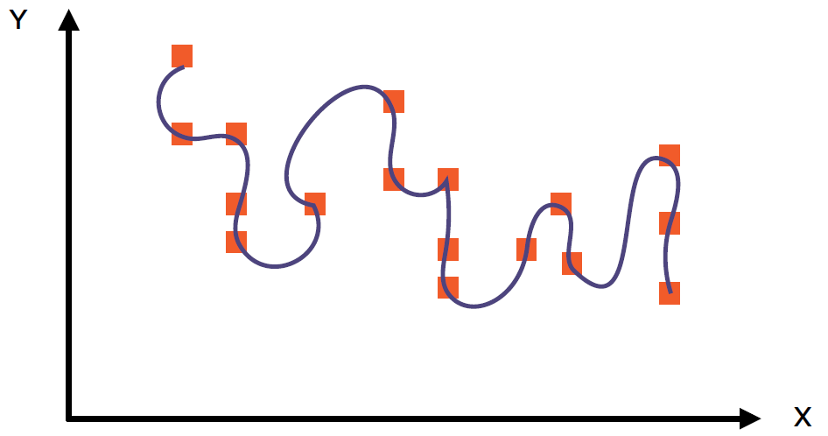
Project analysis slide 10
Factors Impacting Deployed Models
The problem we face is that the models perform worse in production than in development.
1. Overfitting
Great performance in training, poor performance in real usage.
Solution:
Cross-Validation
Training With More Data
Removing Features
Early Stopping
Regularization
Ensemble

Slide 20
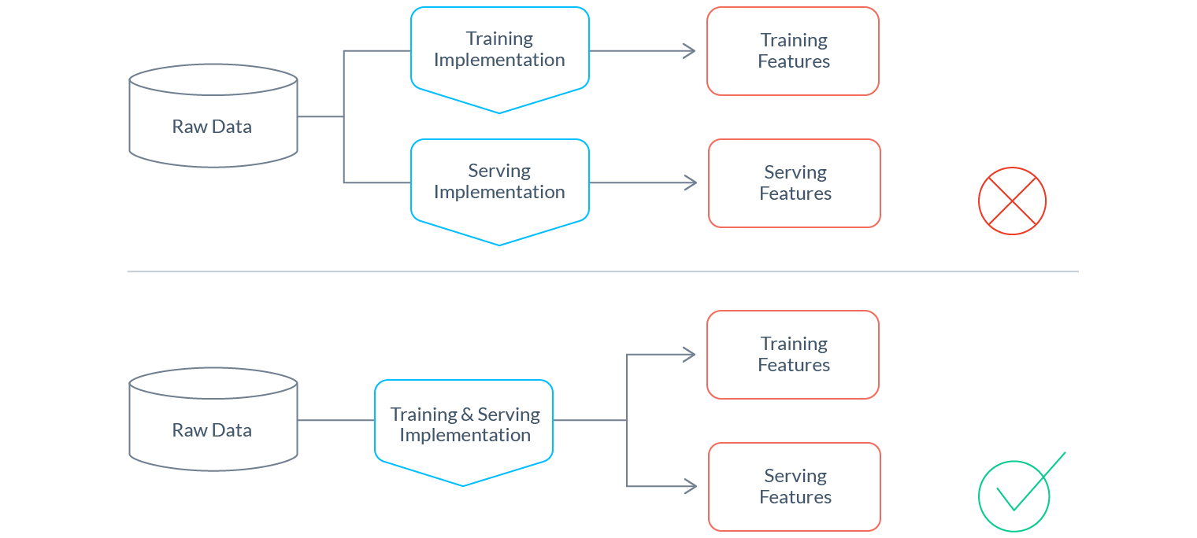
Project analysis slide 10
Factors Impacting Deployed Models
The problem we face is that the models perform worse in production than in development
Training-serving Skew
Occurs when the live data is not pre processed the way as the test date.
Solution:
we should re-use the same feature engineering code to guarantee that a given raw input maps to the same feature vector at training and serving time.

Slide 21
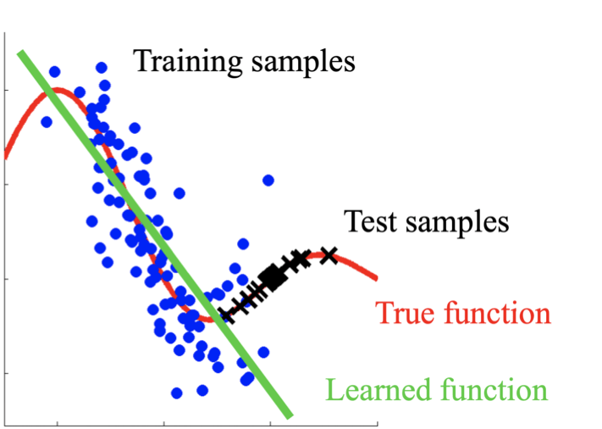
Project analysis slide 10
Factors Impacting Deployed Models
The problem we face is that the models perform worse in production than in development
Concept Drift
Relationships between the features and the target label changes over time due forever changing environment e.g. politics, climate change, consumer behaviour, and etc.
Solution:
Understand the change and factor it into feature Engineering
Keep monitoring and retraining deployed models
Re-develop models from scratch (if re-training won’t suffice)

Slide 22
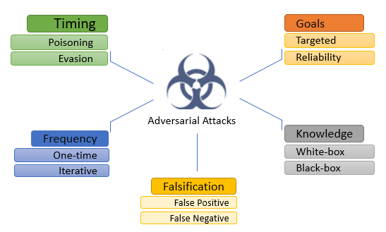
Project analysis slide 10
Factors Impacting Deployed Models
The problem we face is that the models perform worse in production than in development
Concerted Adversaries
Inputs to machine learning models that an attacker has intentionally designed to cause the model to make a mistake.
Solution:
Human minders for models becoming more important.
Human minders learn from cases where models got it wrong.
Back to the future: From machine learning to manual learning.

Slide 23
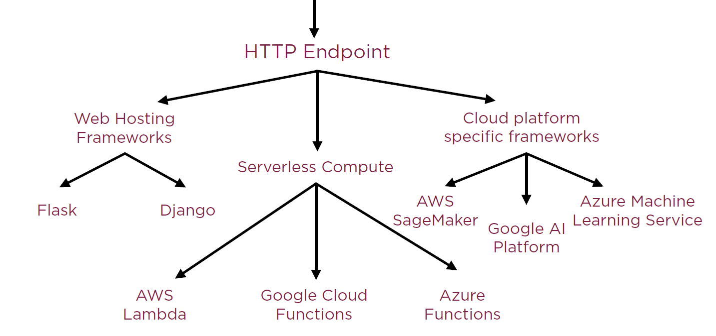
Project analysis slide 10
Deploying Models for Prediction

Slide 24
Project analysis slide 10
Deploying Models for Prediction
Server less computing with google cloud platform was selected as the best option.
With server less computing, the infrastructure logistics remain with the supplier.
The machine learning code is uploaded as a pickle file into the cloud.
A bucket is created to contain the model.
Then a function is created to trigger the model when it is called.
Then the model can be called as a rest API.

Slide 25
Thank You

Slide 26
Project analysis slide 11
Personal Reflection
Develop more skills on MLOPs and software engineering

